Slide 1
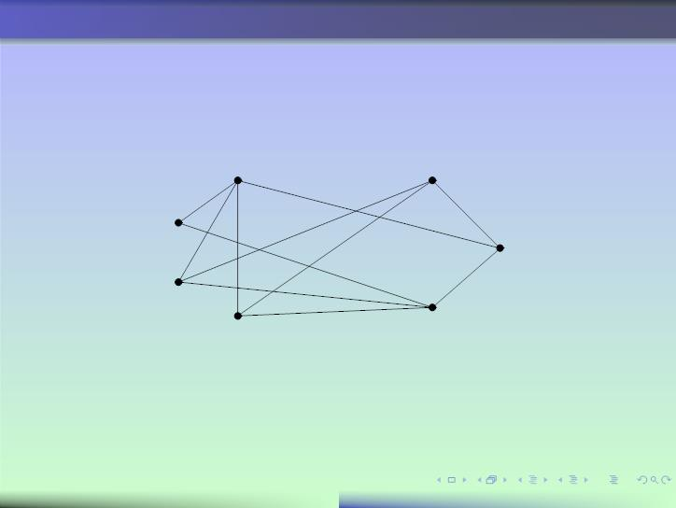

f
g
b
e
a
d
c
Bipartite Graphs
3

Slide 2

f
g
b
e
a
d
c
Bipartite Graphs
3

Slide 3
Introduction
Bipertite or not
Complete Bipertite Graph
Real Life Applications of Bipertite Graph
Table of contents
-------------------------------
f
g
b
e
a
d
c
Bipartite Graphs
3

Slide 4
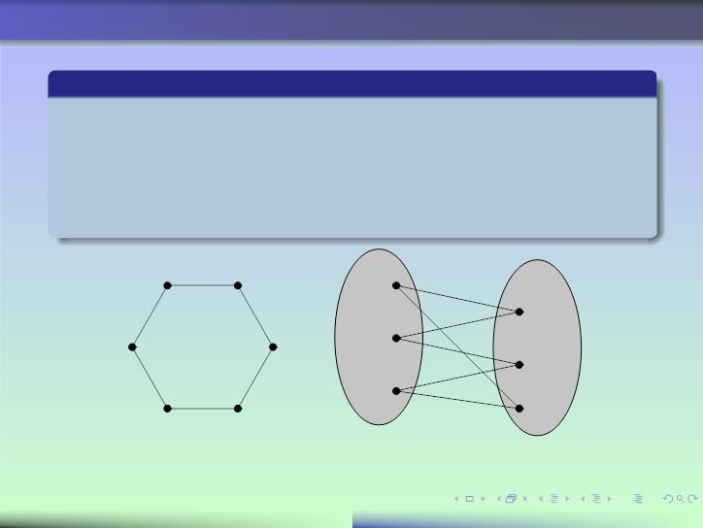
Deﬁnition
A simple graph G is called bipartite if its vertex set V can be
partitioned into two disjoint sets V and V such that every edge
2
in the graph connects a vertex in V and a vertex in V (or, there
1
1
2
is no edge between vertices of subset V₁ and between vertices of
subset V₂).
^{v}1
^{v}2
v₁
v₂
v₆
v₃
^{v}3
v₄
v₆
v₅
v₅
v₄
V₁
V₂
Showing that C₆ is bipartite
Bipartite Graphs
2

Slide 5
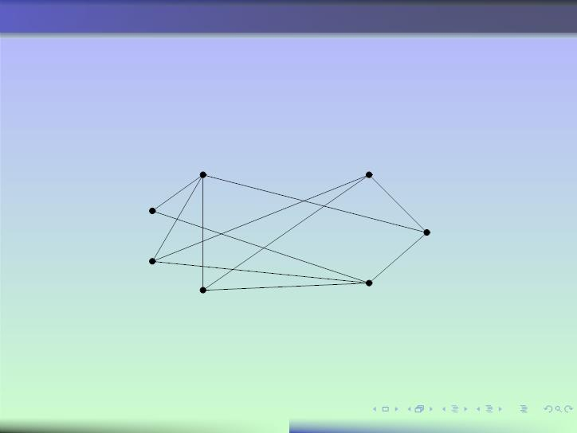
Is this graph bipartite or not ?
We label one vertex of the graph with the color blue. How to
choose this ﬁrst vertex? Simply choose the ﬁrst one in
lexicographic order.
f
g
e
a
d
c
b
Level 1 (Blue) : a
Bipartite Graphs
4

Slide 6
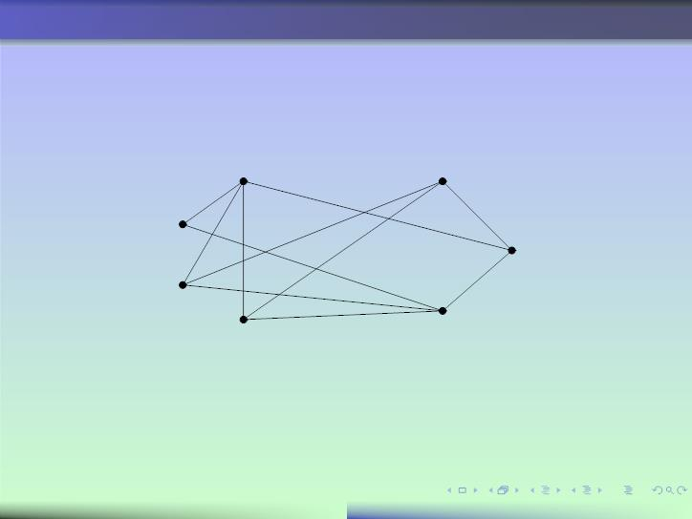
The adjacent vertices b, f and g of the ﬁrst vertex a must be of
the other color. We label them with the red color.
f
g
e
a
d
c
b
Level 1 (Blue) : a
Level 2 (Red) : b, f and g
Bipartite Graphs
5

Slide 7
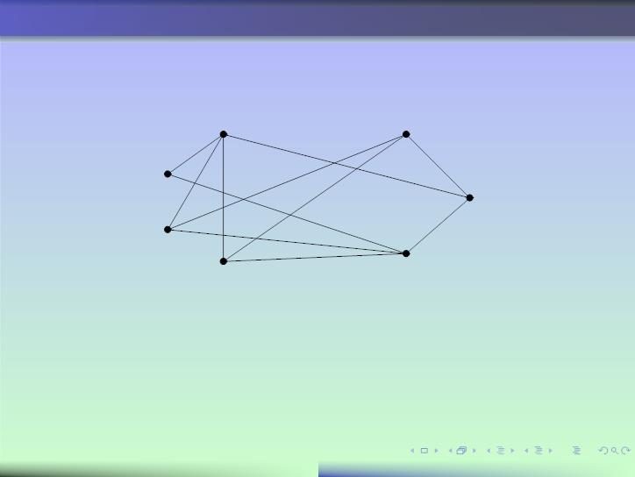
The adjacent vertices to b, f and g must be of the other color.
We label them with the blue color.
f
g
e
a
d
c
b
Level 1 (Blue) : a
Level 2 (Red) : b, f and g
Level 3 (Blue) : c, d and e
At the end of the process, if all the vertices have one unique label,
then the graph is bipartite.
Bipartite Graphs
6

Slide 8
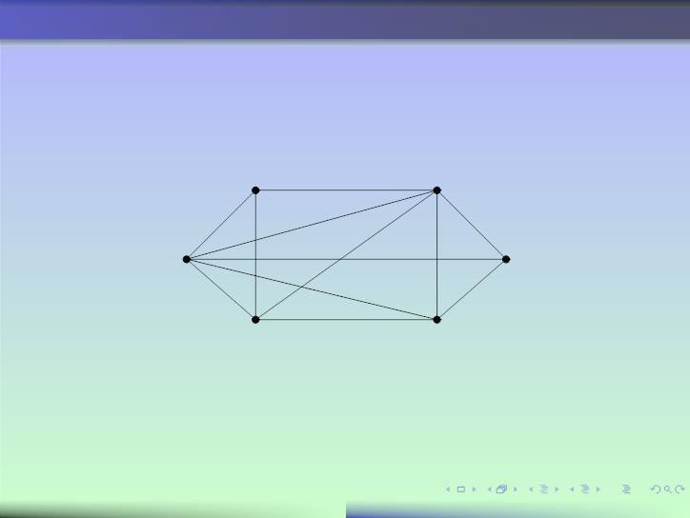
Is this graph bipartite or not ?
We label one vertex of the graph with the color blue. For this, we
choose the ﬁrst vertex in lexicographic order.
e
f
d
a
c
b
Level 1 (Blue) : a
Bipartite Graphs
8

Slide 9
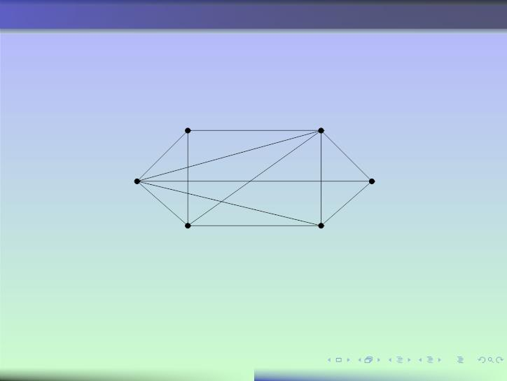
The adjacent vertices b, d and f of the ﬁrst vertex a must be of
the other color. We label them with the red color.
e
f
d
a
c
b
Level 1 (Blue) : a
Level 2 (Red) : b, d and f
Bipartite Graphs
9

Slide 10
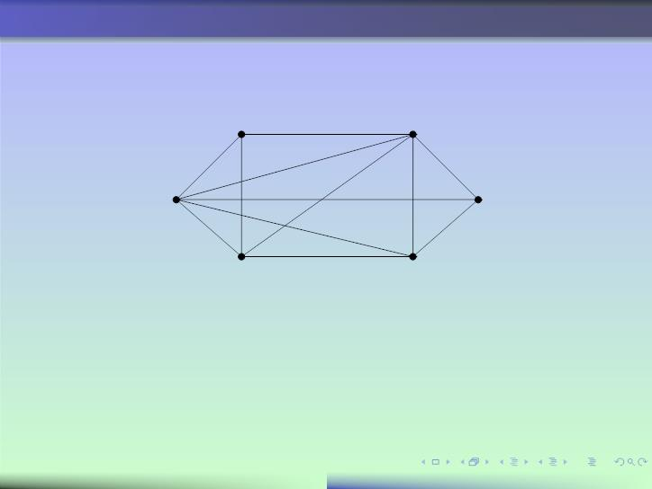
The adjacent vertices to vertices b, d and f must be of the other
color. We label them with the blue color.
e
f
dd
a
c
b
Level 1 (Blue) : a
Level 2 (Red) : b, d and f
Level 2 (Red) : c, d ???
As soon as one vertex must have two diﬀerent colors, the graph is
not bipartite.
Bipartite Graphs
10

Slide 11
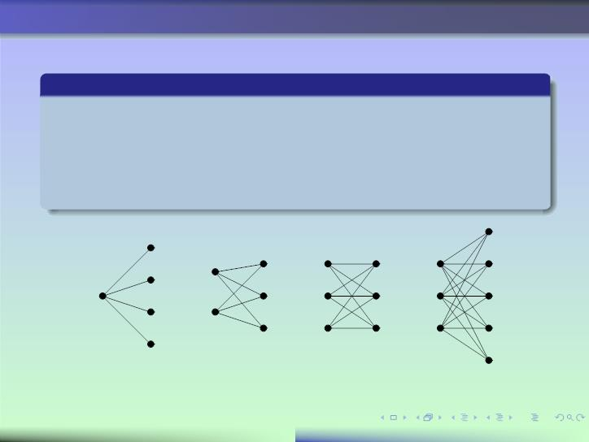
complete bipartite graph
Deﬁnition
The complete bipartite graph K_{m,n} is the graph that has its
vertex set partitioned into two subsets of m and n vertices,
respectively. There is an edge between two vertices if and only if
one vertex is in the ﬁrst subset and the other vertex in the second
subset.
^{K}1,4
K_{2,3}
K_{3,3}
K_{3,5}
Bipartite Graphs
11

Slide 12
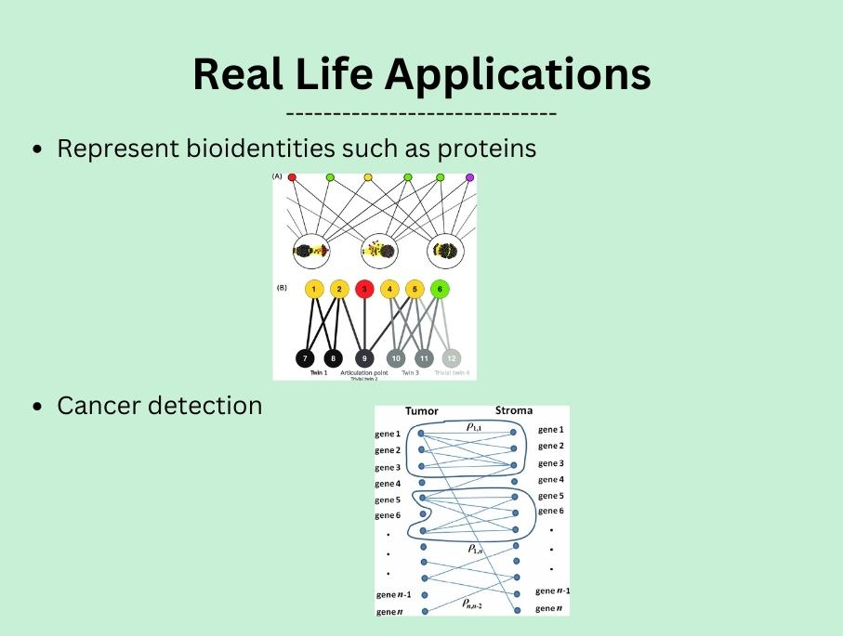
Deﬁnition
The complete bipartite graph K_{m,n} is the graph that has its
vertex set partitioned into two subsets of m and n vertices,
respectively. There is an edge between two vertices if and only if
one vertex is in the ﬁrst subset and the other vertex in the second
subset.
^{K}1,4
K_{2,3}
K_{3,3}
K_{3,5}
Bipartite Graphs
11

Slide 13
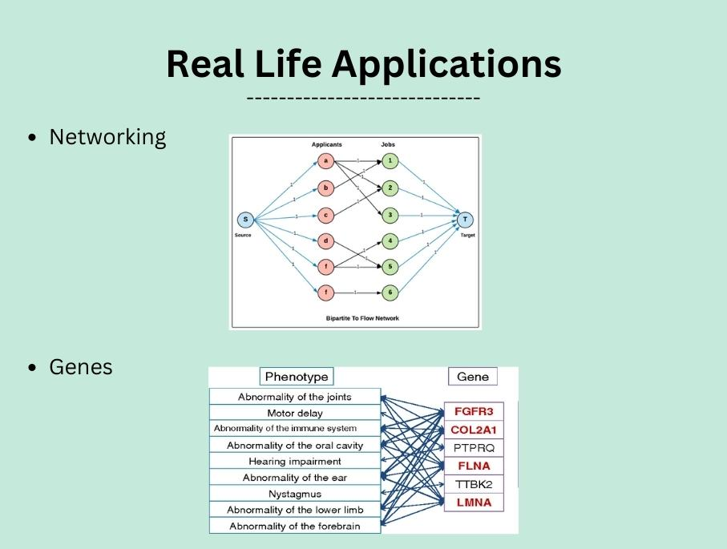
Deﬁnition
The complete bipartite graph K_{m,n} is the graph that has its
vertex set partitioned into two subsets of m and n vertices,
respectively. There is an edge between two vertices if and only if
one vertex is in the ﬁrst subset and the other vertex in the second
subset.
^{K}1,4
K_{2,3}
K_{3,3}
K_{3,5}
Bipartite Graphs
11

Slide 14

Deﬁnition
The complete bipartite graph K_{m,n} is the graph that has its
vertex set partitioned into two subsets of m and n vertices,
respectively. There is an edge between two vertices if and only if
one vertex is in the ﬁrst subset and the other vertex in the second
subset.
^{K}1,4
K_{2,3}
K_{3,3}
K_{3,5}
Bipartite Graphs
11

